Slide 1


R Package Development
October 29, 2024

Slide 2

R Package Development
Today’s Co-organizer:
Keenan Manpearl
keenan.manppearl@cuanschutz.edu
Event Co-leaders:
Ella Chen, Kat Terwelp
and Janani Ravi
Today’s Instructor:
Zhixin Lun
zhixin.lun@cuanschutz.edu
Volunteer signup: https://bit.ly/RLA-fall24volunteer
Adapted materials from:
Today’s sponsor:

Slide 3
Thank you to today’s sponsor
Dr. James Mitchell's research encompasses AI, HCI, UCD, mobile applications, and wearables. His studies investigate augmented reality applications for public engagement and user-centered design for clinical guidelines on mobile devices. He measures healthcare professionals' experiences with AI technologies and leverages allied health data to improve AI applications, focusing on social determinants of health and intersectionality. Additionally, Dr. Mitchell designs user-centered solutions and explores the potential of large language models (LLMs) in both clinical settings and user-centered design studies. His work aims to advance healthcare technology through innovative AI solutions and user-centered design methodologies.

Slide 4

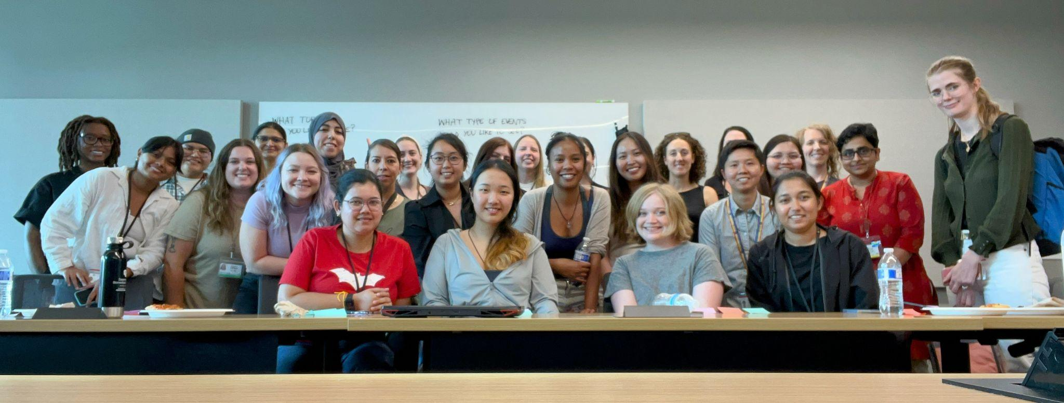
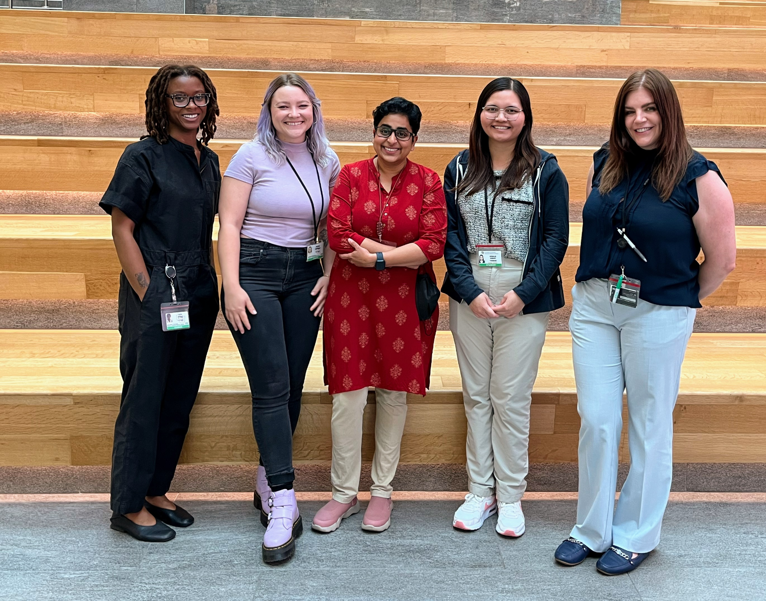
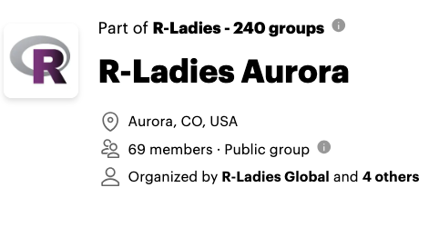
Who We R!?
R-Ladies Kick-off Event on Jul 25, 2024
RLA Co-organizer team: Jade, Keenan, Janani, Kewalin, Stacey (left to right)

Slide 5
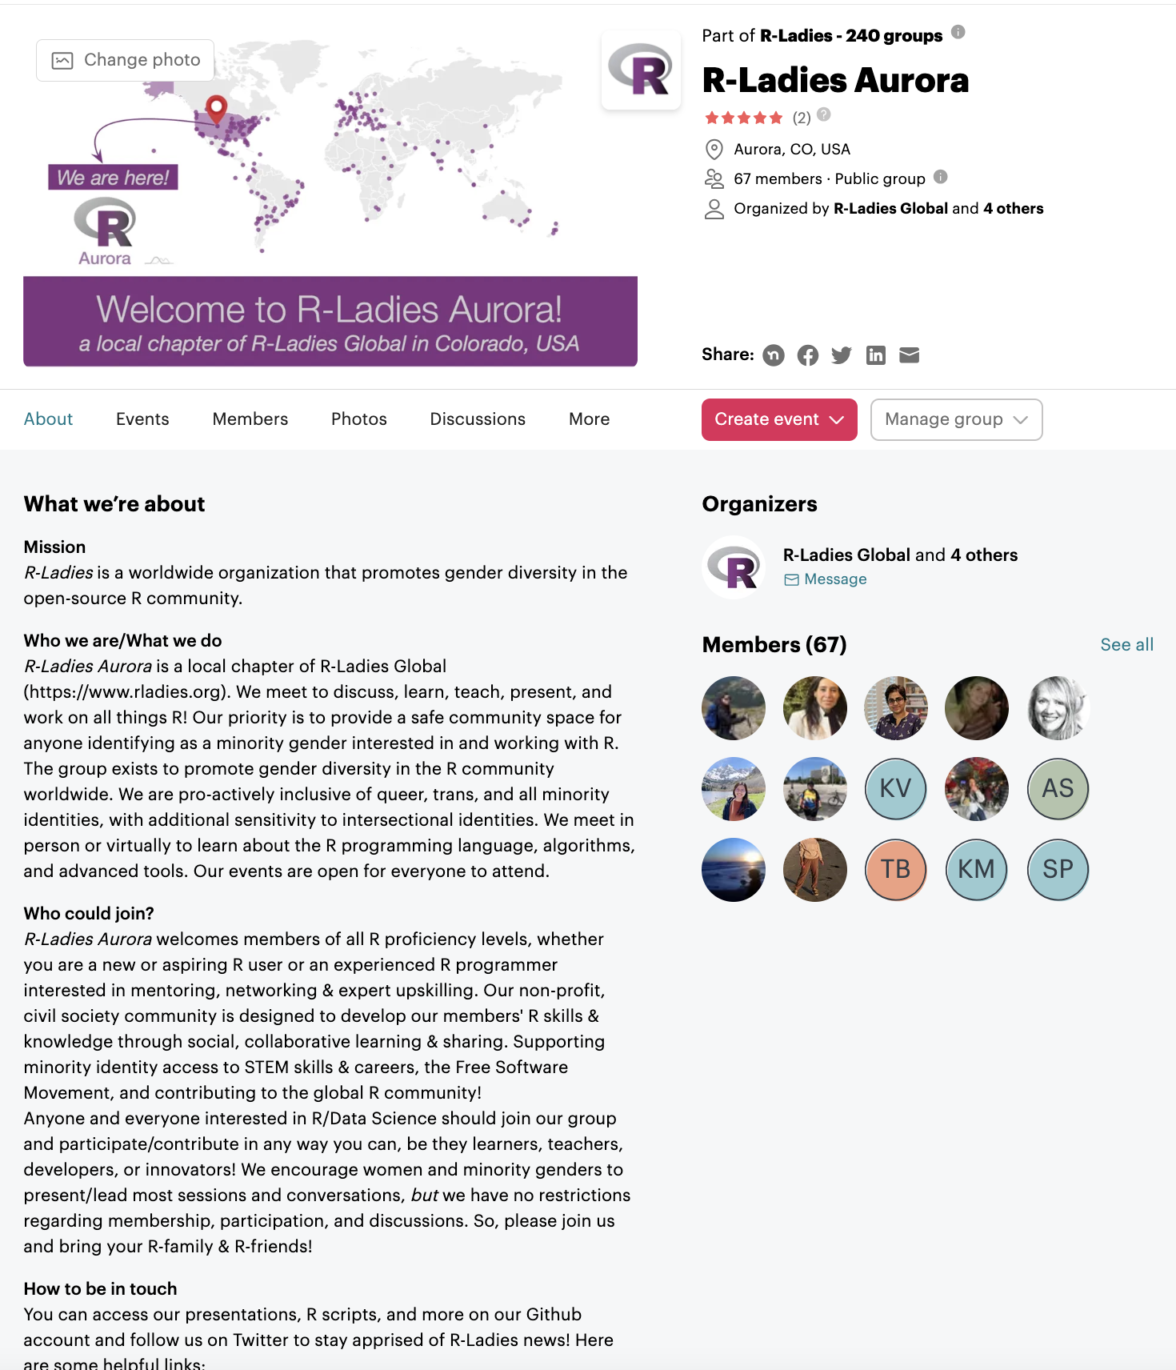

New Members?
1. Join us, RSVP for events on Meetup
https://www.meetup.com/rladies-aurora/
2. Join our discussion forum on Discord
https://discord.gg/EXKYNCSFBk

Slide 6


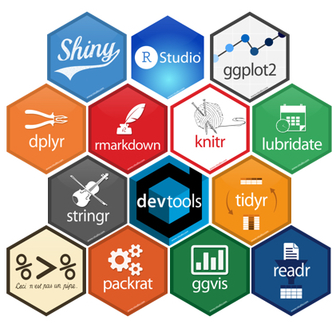

Upcoming Workshops
Fall’ 24 R-Ladies Aurora Series:
Intro to R Functions
DataViz 2.0
R Package Development
Presenting to Non-Scientific Audiences
Python in R

Slide 7
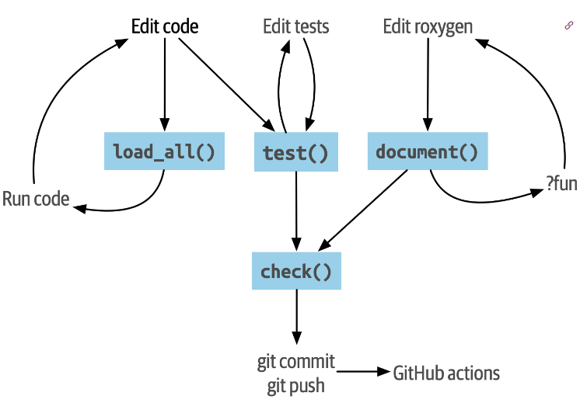
Today! Oct 29, 2024
TOPICS
R Package Development
Ping us on Discord with any Questions
Figure: The devtools package development workflow.
https://r-pkgs.org/whole-game.html

Slide 8
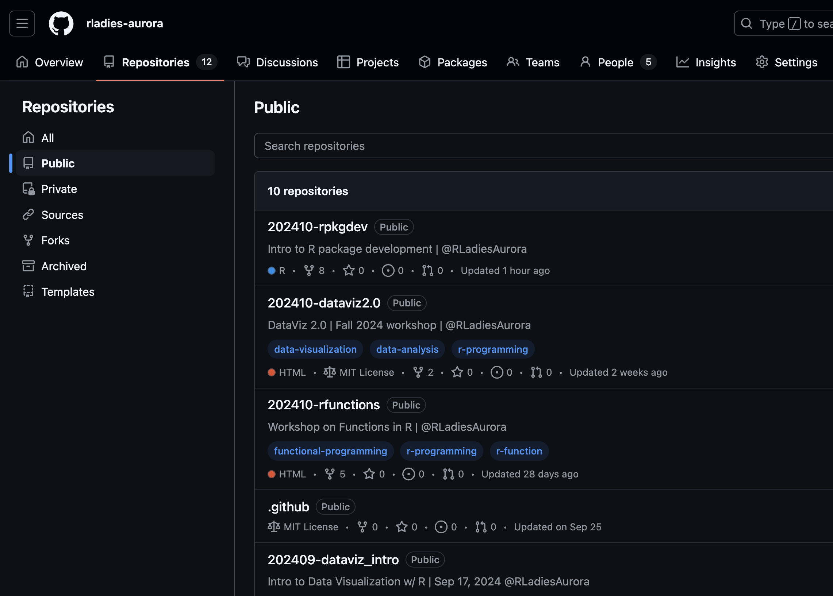
Presentation Materials
https://github.com/rladies-aurora/202410-rpkgdev/
One script: f_to_c_human.R

Slide 9

Intro | Meet & Greet
Pizza + Sign-up
Familiar w/ R and ggplot? → Shuffle
Introduce yourself to your neighbor
Who you are | Name, affiliation
Do you have the same version of R (4.0+), RStudio & Tidyverse?
NO? Installation time!
https://rstudio-education.github.io/hopr/starting.html
Need help? Pink sticky up! All set: Blue!

Slide 10
Outline
This is a hands-on workshop
The workflow of R package development using RStudio and other key packages
The goal is to understand the basic structure of R package and the workflow of package development

Slide 11
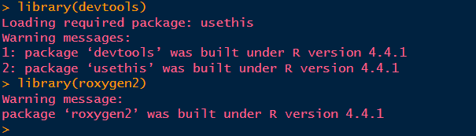
Preparation
Please install the following packages in RStudio
devtools - Tools to Make Developing R Packages
roxygen2 – Generate Documentation for R
Check if these packages get installed in your RStudio environment

Slide 12

Demo time!

Slide 13
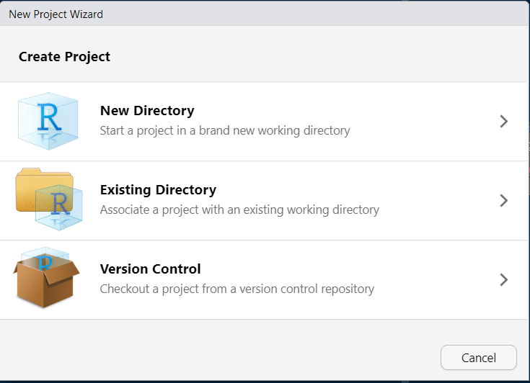
Step 1: Create a R package project in RStudio
File -> New Project -> New Directory

Slide 14
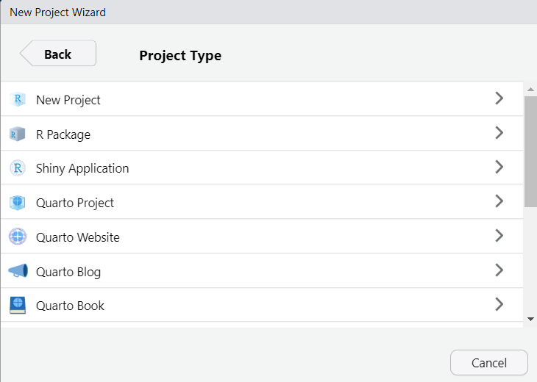
Step 1: Create a R package project in RStudio
Select “R Package”

Slide 15
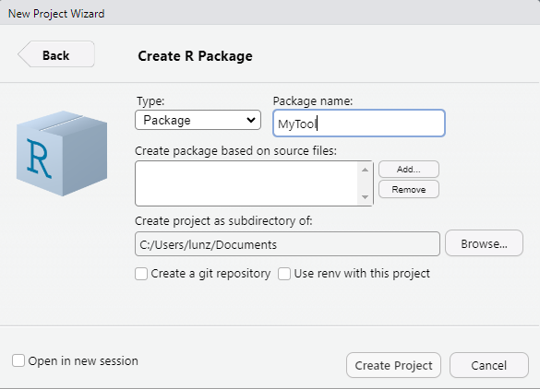
Step 1: Create a R package project in RStudio
Enter “MyTool” under the Package Name
Choose the path for the project directory

Slide 16
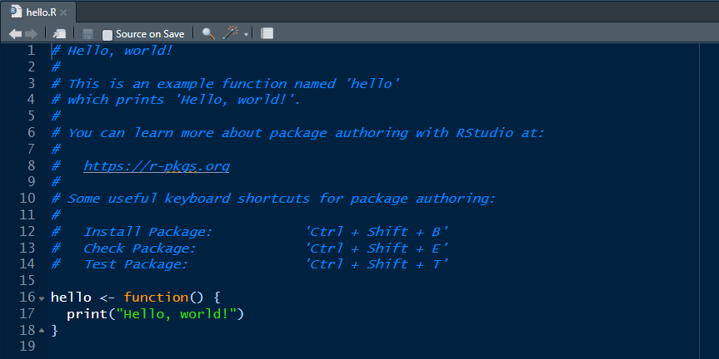
Step 1: Create a R package project in RStudio
A default function “hello.R” is displayed.

Slide 17
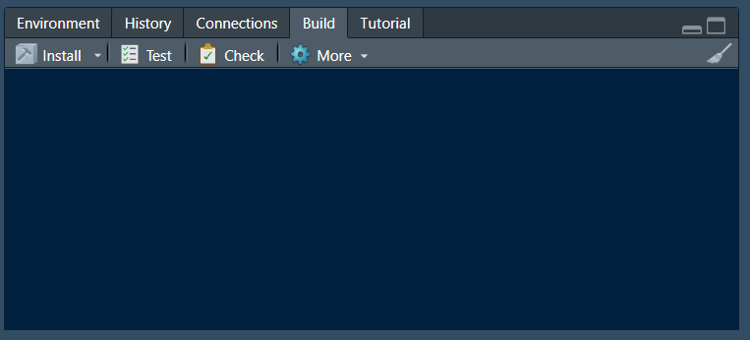
Step 1: Create a R package project in RStudio
A new tab “Build” in RStudio

Slide 18
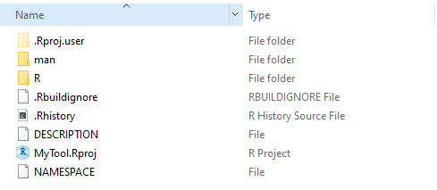
The Basic Structure of R package
R function documentation
R function source code
R package description

Slide 19
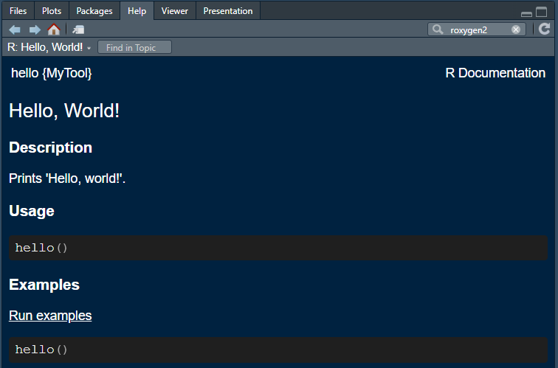
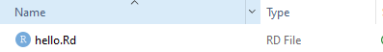
The Basic Structure of R package
“?” + “function name” outputs the R documentation
For example, “?hello” in R Console
The content of R Documentation is set up by the .Rd file inside the folder man.

Slide 20
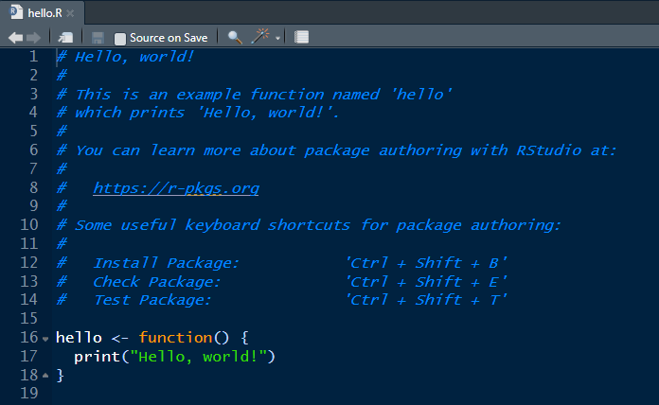
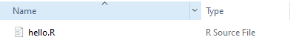
The Basic Structure of R package
The source code of R function
The source R functions are stored inside the folder R.

Slide 21
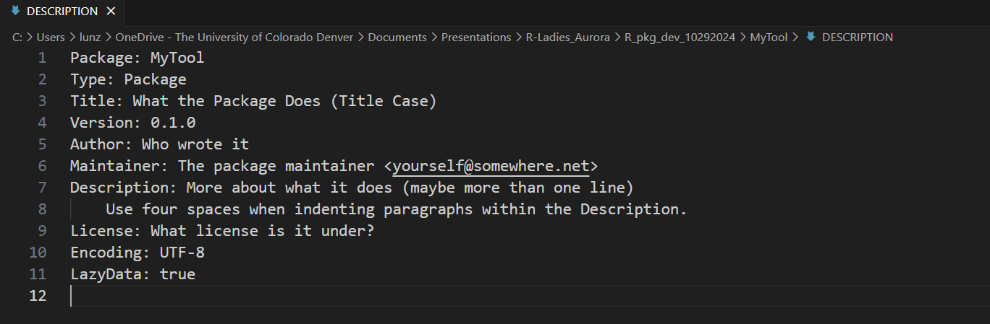
The Basic Structure of R package
DESCRIPTION is a big picture of R package and provides metadata about your package
File -> Open File -> Select DESCRIPTION

Slide 22
The Basic Structure of R package
If I have seen further, it is by standing on the shoulders of giants.
- Sir Isaac Newton
Learning from the existing popular packages is always a best way to learn R package structure.

Slide 23
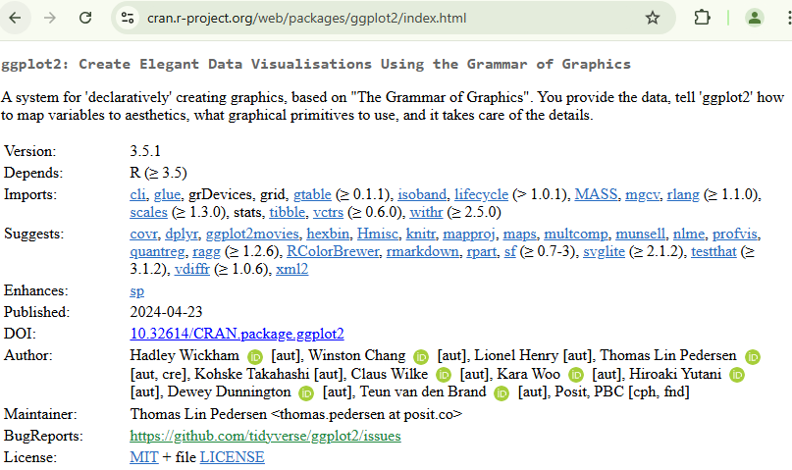
The Basic Structure of R package

Slide 24
Step 2: Set up DESCRIPTION file
Package Version Number

Slide 25
Step 2: Set up DESCRIPTION file
Formally, an R package version is a sequence of at least two integers separated by either . or -.
1.0 and 0.9.1-10 are valid versions
1 and 1.0-devel are not
<major>.<minor>.<patch> # released version
<major>.<minor>.<patch>.<dev> # in-development version

Slide 26
Step 2: Set up DESCRIPTION file
Recommended framework by Hadley Wickham:
Always use . as the separator, never -.
A released version number consists of three numbers, <major>.<minor>.<patch>. Always spell out the three components, 1.0.0.
The version 1.0.0 often signals that the public interface of a package is considered stable.
An in-development package has a fourth component: the development version.

Slide 27
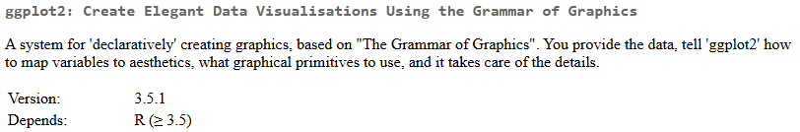
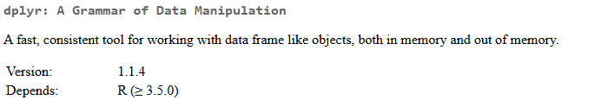
Step 2: Set up DESCRIPTION file

Slide 28
Step 2: Set up DESCRIPTION file
Author

Slide 29
Step 2: Set up DESCRIPTION file
Authors@R:
person("First", "Last", , "first.last@example.com", role = c("aut", "cre"),
comment = c(ORCID = "YOUR-ORCID-ID"))

Slide 30
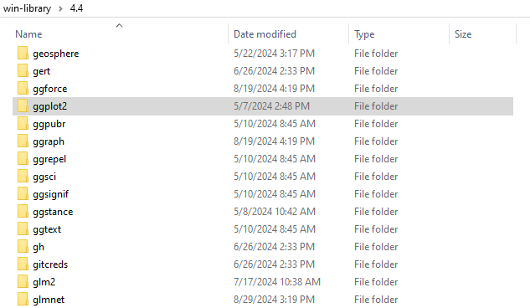
Step 2: Set up DESCRIPTION file
A best way to understand the format is to refer existing popular packages.

Slide 31
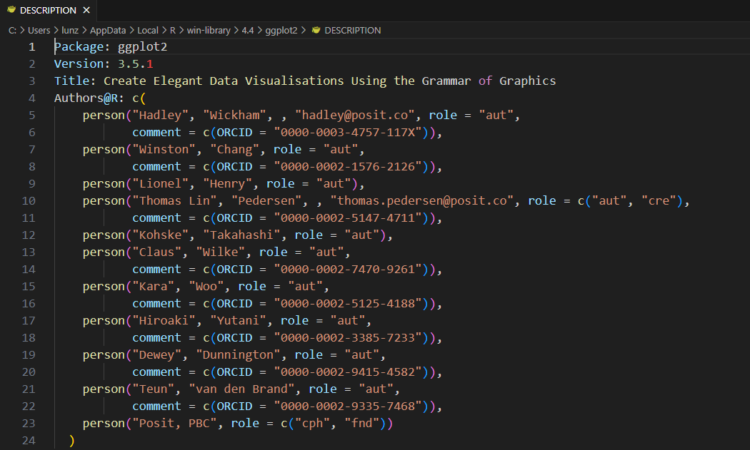
Step 2: Set up DESCRIPTION file

Slide 32
Step 2: Set up DESCRIPTION file
License

Slide 33
Step 2: Set up DESCRIPTION file
License options: MIT, GPL, etc.
Permissive licenses are very easy going. Code with a permissive license can be freely copied, modified, and published, and the only restriction is that the license must be preserved. The MIT and Apache licenses are the most common modern permissive licenses; older permissive licenses include the various forms of the BSD license.
Copyleft licenses are stricter. The most common copyleft license is the GPL which allows you to freely copy and modify the code for personal use, but if you publish modified versions or bundle with other code, the modified version or complete bundle must also be licensed with the GPL.

Slide 34
Step 2: Set up DESCRIPTION file
Example:
MIT License: https://cran.r-project.org/web/packages/ggplot2/index.html
GPL License: https://cran.r-project.org/web/packages/survival/index.html

Slide 35
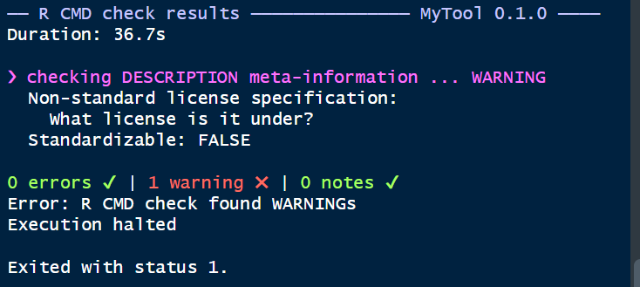
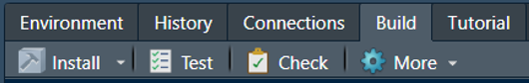
Step 2: Set up DESCRIPTION file
Why we spend a long time in understanding the DESCRIPTION file?
Because R package generation requires a standard series of CHECKING!

Slide 36
Step 2: Set up DESCRIPTION file
You would encounter several warnings/notes message during R package checking.
Each warning or note message will teach you what you should pay attention.

Slide 37
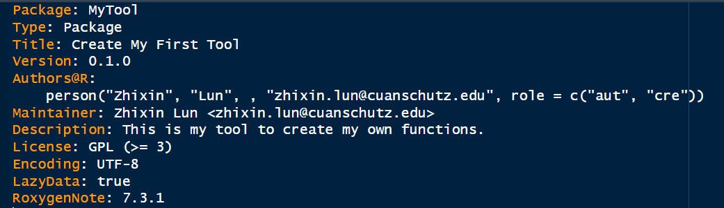
Step 2: Set up DESCRIPTION file
We choose GPL license in this demo.
Option 1: Edit directly in DESCRIPTION file
Option 2: use_gpl3_license() in R Console

Slide 38
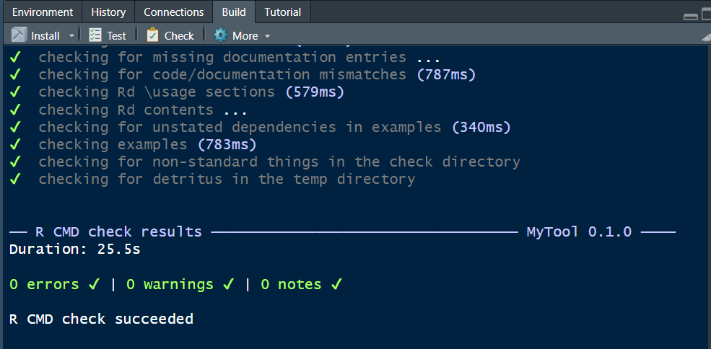
Step 2: Set up DESCRIPTION file
Let’s CHECK the R package again.
Congratulations!
This is a great start!

Slide 39
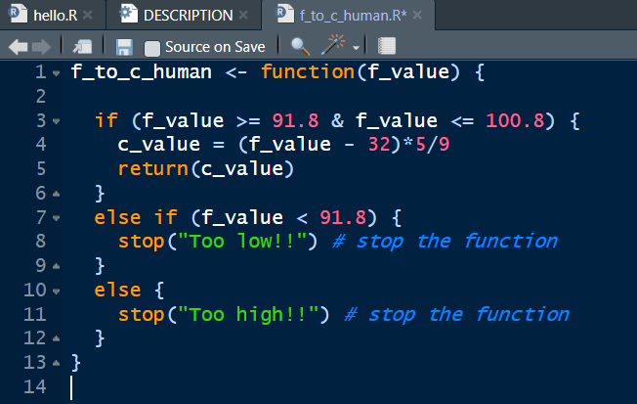
Step 3: Add your own new functions
The purpose of R package development is to manage new R functions and make it reliable and transparent to other R users.
Let’s create a new R function: File -> New File -> R Script
We continue to use the function for converting the temperature from Fahrenheit to Celsius

Slide 40
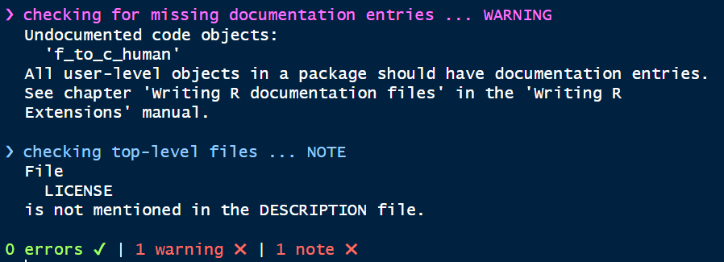
Step 3: Add your own new functions
Let’s CHECK the package.
This warning tells us the R documentation was missing for the function f_to_c_human().

Slide 41
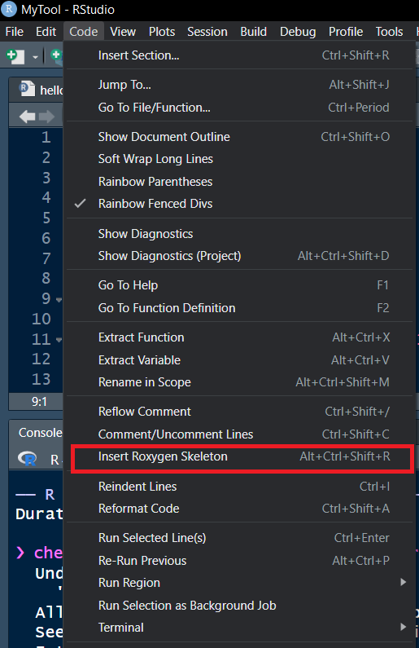
Step 3: Add your own new functions
Create a R documentation file using roxegen.
Code -> Insert Roxygen Skeleton

Slide 42
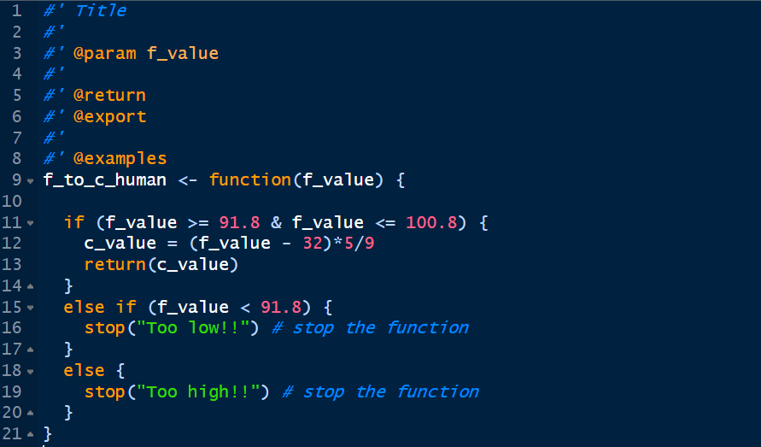
Step 3: Add your own new functions

Slide 43
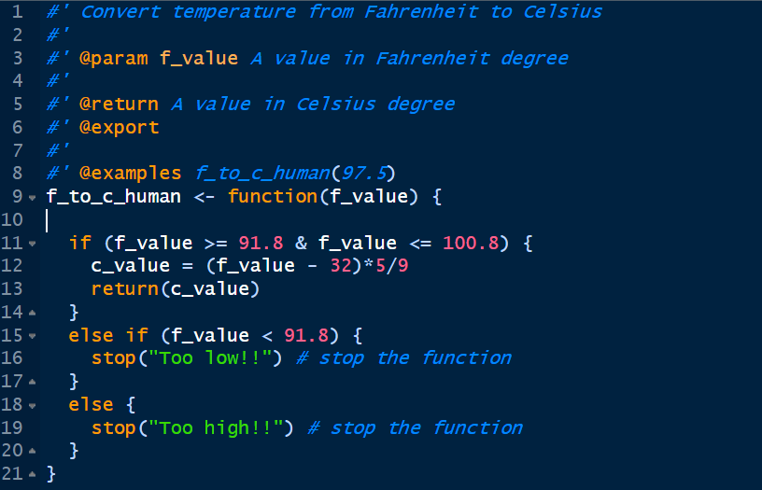
Step 3: Add your own new functions

Slide 44
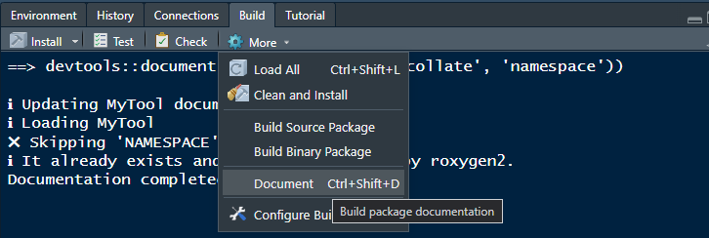
Step 3: Add your own new functions
Build -> Document
When you see “Documentation completed” -> Succeed!

Slide 45
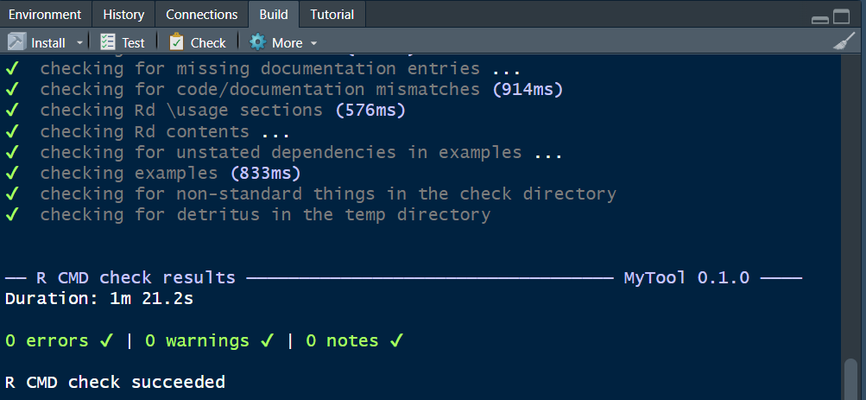
Step 3: Add your own new functions
Let’s CHECK the R package again.
Congratulations!
This is a great start!

Slide 46
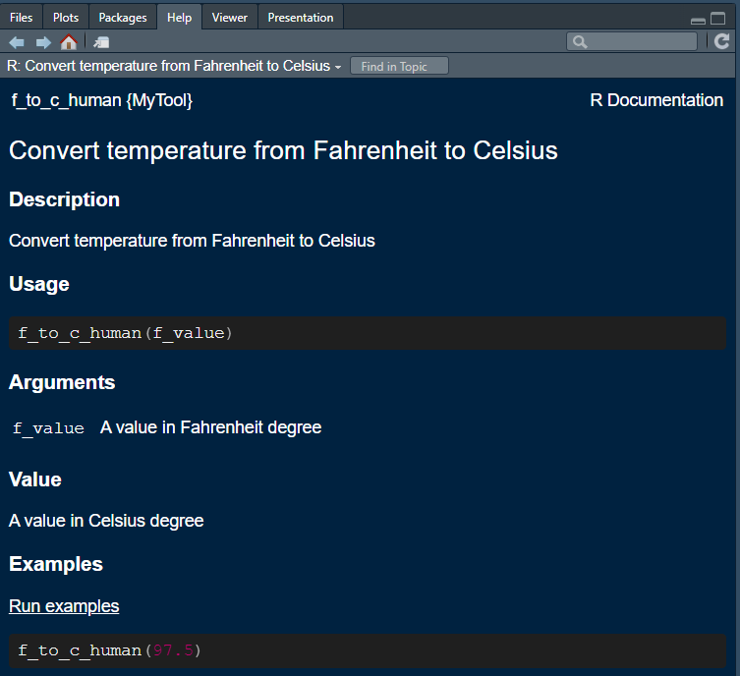
Step 4: Install and preview your package
library(MyTool) or
?f_to_c_human in R Console
Click the link of Run examples ->

Slide 47
Distributing Packages
https://support.posit.co/hc/en-us/articles/200486508-Building-Testing-and-Distributing-Packages
Publicly
Contributing packages to CRAN
Publishing on R-Forge or GitHub

Slide 48
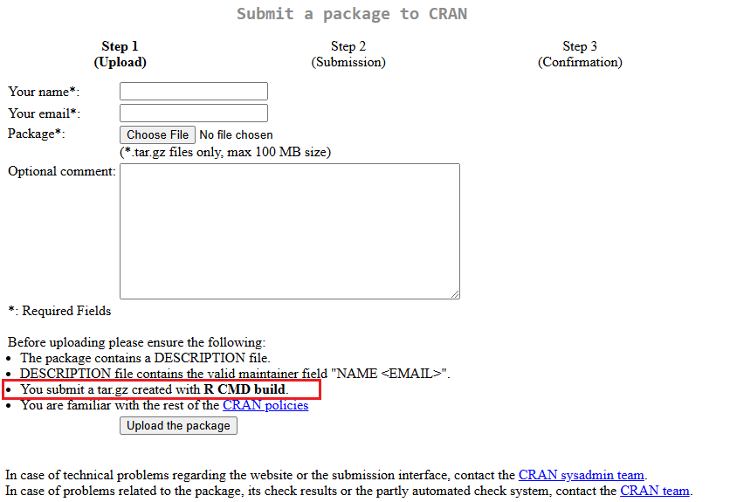
Distributing Packages to CRAN
https://cran.r-project.org/submit.html
.tar.gz files only!

Slide 49
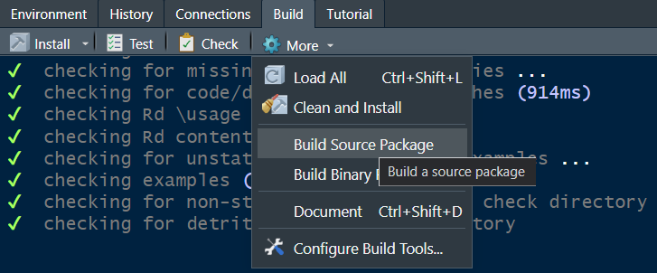
Distributing Packages to CRAN
Generate R source package -> .tar.gz file

Slide 50
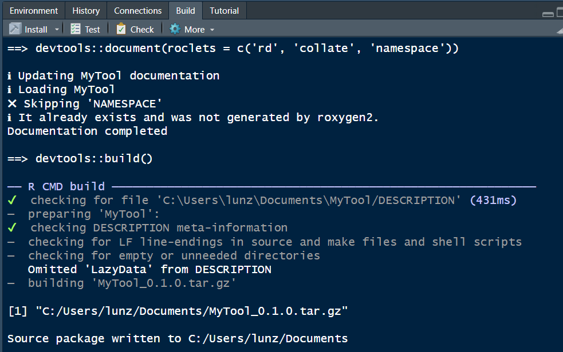
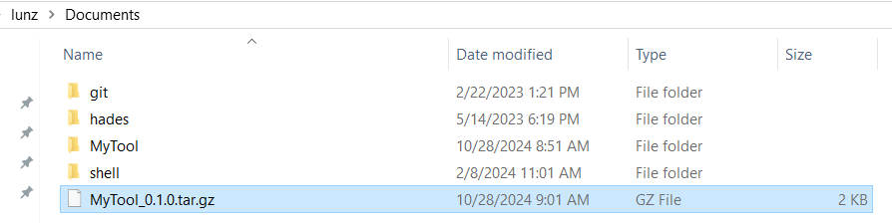
Distributing Packages to CRAN

Slide 51
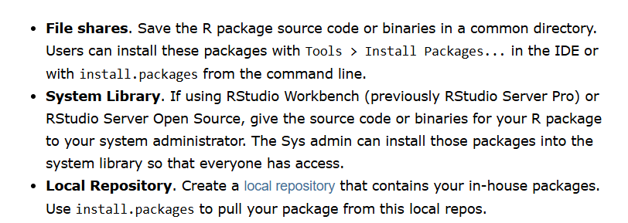
Distributing Packages Privately
https://support.posit.co/hc/en-us/articles/200486508-Building-Testing-and-Distributing-Packages

Slide 52
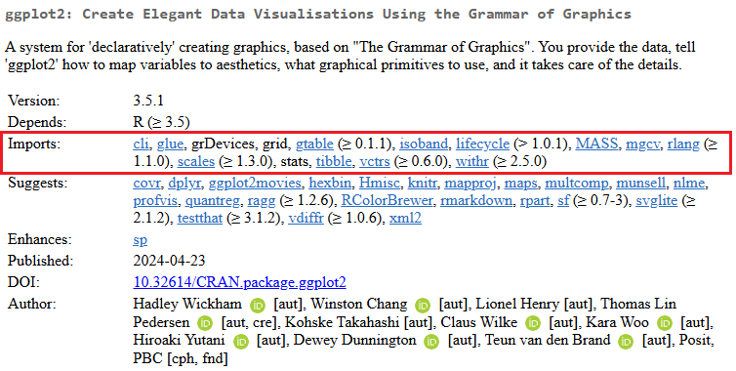
Advanced topics not mentioned today
Further development or reuse of some functions from other packages. Need to add those packages into “Import” -> Think about how to do it?

Slide 53
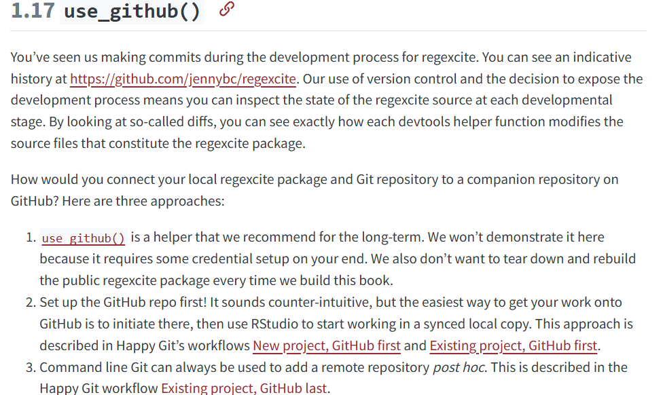
Advanced topics not mentioned today
Use GitHub to manage your package: https://r-pkgs.org/whole-game.html#use_github

Slide 54
Useful Materials
R for Data Science https://r4ds.had.co.nz/
Advanced R https://adv-r.hadley.nz/
Best Coding Practices for R
https://bookdown.org/content/d1e53ac9-28ce-472f-bc2c-f499f18264a3/
R Packages (2e) https://r-pkgs.org/

Slide 55
Thank you!
R-Ladies Aurora

